Slide 1

SAFETY PART TRAINING –SUB-TIER SUPPLIERS
JANUARY 2024
© 2020 Collins Aerospace
Collins Aerospace Proprietary. This document contains no export controlled technical data.

Slide 2

PURPOSE
The purpose of this sub-tier supplier training is to establish:
Standard definitions & acronyms
Understanding of why the safety part program exists (video)
Flight Safety Training Video (password: Collins)
Understanding of the approval process
Build to Print and Design Responsible
Continued training expectations
© 2020 Collins Aerospace
Collins Aerospace Proprietary. This document contains no export controlled technical data.
2

Slide 3

ACRONYMS
CTQ: Critical to Quality
CTQC: Critical to Quality Characteristic
CTSC: Critical to Safety Characteristic
FPRB: Frozen Process Review Board
FSC: Frozen Safety Characteristic
KPC: Key Product Characteristic
SP: Safety Part
PSIT: Product Safety Integrity Team
 | © 2020 Collins Aerospace Collins Aerospace Proprietary. This document contains no export controlled technical data. 3

Slide 4
DEFINITIONS
HSC16199 Safety Parts for Collins Aerospace
Safety Part (SP)* (per HSC16199 1.3.10)
A detailed part, assembly, high energy rotating part containment, or software, whose failure or malfunction (failure to operate due to improper assembly, installation process, omission of parts, wear, etc.) could directly result in an unsafe condition
or
whose failure or malfunction causes a subsequent failure(s) which could directly result in an unsafe condition.
SPs will ordinarily be identified at the detail part level. An assembly may be identified as an SP if it has Safety Characteristics at the assembly level, or contains SP details.
*Formally Flight Safety Part
 | © 2020 Collins Aerospace Collins Aerospace Proprietary. This document contains no export controlled technical data. 4

Slide 5

DEFINITIONS
Safety Drawings may include:
Frozen Safety Characteristic
Frozen Process Management
100% inspection
If not produced within the prescribed acceptance limits could result in loss of life or loss of aircraft
Key Process Characteristic 1 (safety)
Statistically managed safety characteristic
100% inspection
KPC1
If not produced within the prescribed acceptance limits could directly result in an unsafe condition
Critical To Safety Characteristic
CTSC
Safety Function defined on procurement spec or drawing
Supplier design product must define characteristics to control to assure safety function is fully “viable” upon delivery
© 2020 Collins Aerospace
Collins Aerospace Proprietary. This document contains no export controlled technical data. 5

Slide 6
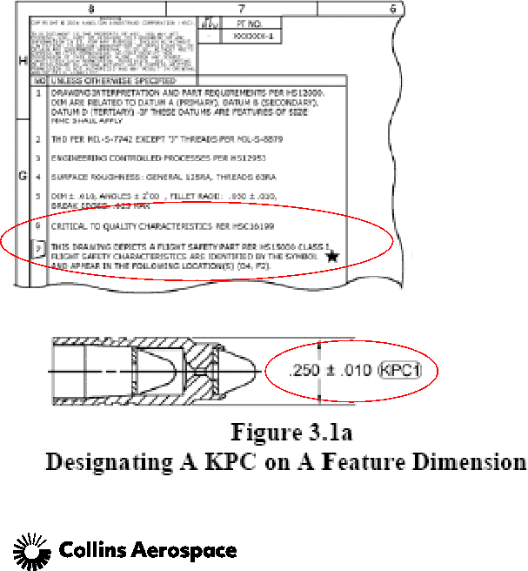
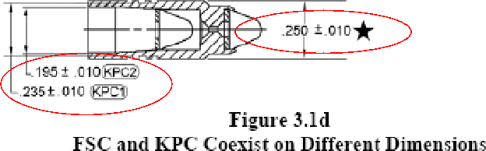
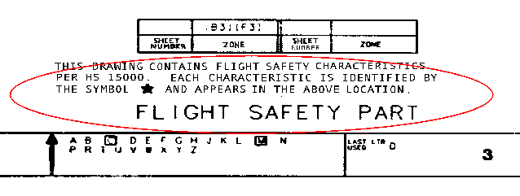
DRAWING EXAMPLES
 | © 2020 Collins Aerospace Collins Aerospace Proprietary. This document contains no export controlled technical data. 6

Slide 7

PROCESS FLOW 1. Identify Frozen Safety Characteristics defined on the drawing (flowdown from customer)
There can be multiple types of FSC’s including, Material, Special process, NDT, dimensions, torque, threads, testing, and more
There may be drawings with no characteristics but reference to an imbedded Safety Part
There may be drawings with no safety characteristics and no reference
2. Supplier creates proposed frozen documentation
This can include: Travelers / Routers, Operation sheets, Technique sheets, weld schedules, Sub-tier supplier documentation, Acceptance Tests Plan
Supplier to include traceability as early as possible
Work with the appropriate resources to create documentation; may include subtiers, Collins’ Project Engineer, etc.
3. Confirm process is approved and frozen by Collins FPRB.
 | © 2020 Collins Aerospace Collins Aerospace Proprietary. This document contains no export controlled technical data. 12

Slide 8
PROCESS FLOW
HSC16199 – FROZEN PROCESS Clarification Part I
There are two methods of frozen process control that may be implemented:
Freeze the “Complete” process; all operations, steps, sequences, etc. in the manufacturing process document identified to produce the safety part / safety characteristic.
Freeze only “Selective” operations in the manufacturing process documents used to produce or inspect the safety characteristics
Note that adding or removing an operation that is not frozen, may affect the frozen operation
The supplier may apply for their desired method but the method to be used is at the discretion of the FPRB.
 | © 2020 Collins Aerospace Collins Aerospace Proprietary. This document contains no export controlled technical data. 13

Slide 9
PROCESS FLOW
HSC16199 – FROZEN PROCESS Clarification Part II
Include a statement of the method of Frozen Process applied, “Complete” or “Selective” on the supplier documents:
For “Complete” it shall include a statement such as “Complete Frozen Process”, no changes to operations or manufacturing sequence without FPRB approval.
For “Selective” it shall include statements that will:
Identify each process element (operations, weld schedules, technique sheets, etc.) that is frozen.
Identify the portion of the process sequence, if any, that is frozen (i.e. “Entire Sequence is frozen” or “Order of frozen processes is frozen” or “Sequence is not frozen and may be done in any order”).
 | © 2020 Collins Aerospace Collins Aerospace Proprietary. This document contains no export controlled technical data. 14

Slide 10
PROCESS FLOW
4. Review cycle with FPRB
May need additional documentation or updated documentation from supplier
5. Approval by the FPRB
The manufacturing process shall be frozen with or before the first delivery of parts following the development of the process
6. Supplier manufactures part to the frozen process
Parts shall be serialized at the earliest possible opportunity in the manufacturing process to maintain traceability.
Raw material shall be traceable to the heat/lot number.
Documented 100% inspection required for all FSCs
 | © 2020 Collins Aerospace Collins Aerospace Proprietary. This document contains no export controlled technical data. 15

Slide 11
PROCESS FLOW
7. Supplier Responsibilities
Supplier must verify that the approved frozen process documentation is the same as what was used to manufacture the part – this must be done for every release
 | © 2020 Collins Aerospace Collins Aerospace Proprietary. This document contains no export controlled technical data. 16

Slide 12
PROCESS FLOW
Changes:
When do changes need to be submitted/approved?
“Complete” Frozen Process – requires submittal/approval for all changes (operations or manufacturing sequence), even if the change does not affect the FSC
Changes to either the design, or the processes that create, inspect, affect or maintain the FSC
Changes must be approved prior to the Supplier implementing the change
“Selective” Frozen Process – only requires submittal/approval if the changes effect the FSC
A partial/delta FAIR is required for all changes.
Rework:
When does rework need to be submitted/approved?
“Complete” Frozen Process – requires submittal/approval for all rework (operations or manufacturing sequence), even if the rework does not affect the FSC
“Selective” Frozen Process – only requires submittal/approval if the rework effects the FSC
 | © 2020 Collins Aerospace Collins Aerospace Proprietary. This document contains no export controlled technical data. 17

Slide 13
PROCESS FLOW ( KPC1) 1. Identify KPC1 on drawing (Safety characteristic without a frozen process) Complete Site Specific Control Plan Complete Gage Study Plan 2. Validate characteristics have been approved by PSIT 3. Manufacture part 4. 100% inspection required for all KPC1’s 5. Provide summary SPC data for KPC1 for each lot to customer | KPC1
 | © 2020 Collins Aerospace Collins Aerospace Proprietary. This document contains no export controlled technical data. 18

Slide 14
TRAINING AND AUDITS
Training is required for: Operators & Inspectors, Procurement, Production Control, Quality Assurance/DQRs, Manufacturing Engineering, Planning, Sub-tier
    Initial Training is required for new employees
    Training includes the Collins video and powerpoint
Annual Safety Audit by Collins SQAR for Special Process sub-tiers listed on Collins 80/85 report as “HSC 16199 – Safety Part Approved”
    Includes review of recent travelers/documentation to assure manufacturing complies to Collins FPRB approved frozen process
    Review of certifications - must have correct revisions, quantities, and be signed
    Collins provides annual Safety training
    Review of final inspection records and any specific 100% inspection records
    Review of serial number logs and traceability requirements
Collins Tier 1 Suppliers shall conduct annual training for everyone associated with the Safety Part Program, including sub-tier suppliers
 | © 2020 Collins Aerospace Collins Aerospace Proprietary. This document contains no export controlled technical data. 47

Slide 15
WRAP UP
Handling: All personnel shall ENSURE that all parts are protected against damage during handling throughout the entire process (including any outside operations) and during shipment.
The supplier shall ensure that all documentation identifies the part as:
“Flight Safety Part Handle and Package with Care”.
A recognized symbol, (black star preferred) that identifies a FSC.
A recognized symbol, that identifies a KPC1.
Documentation includes technique sheets, certifications, test data, etc.
Safety parts should be easily identifiable. Examples: “Flight Safety/Safety Part” stamped on traveler or documents, FS travelers printed on unique color paper, FS jobs in different color job envelope
Record Retention: All manufacturing and inspection records for each lot shall be complete and be available for at least forty years (40).This shall also be flowed down to sub-tiers.
 | © 2020 Collins Aerospace Collins Aerospace Proprietary. This document contains no export controlled technical data. 47

Slide 16
KNOWLEDGE CHECK
Validate your Safety Part Training Knowledge
What is the document that controls Safety parts?
When is review board approval required for changes?
What identifies a frozen safety characteristic?
What is the difference between complete and selective frozen processes?
Can you rework a flight safety part without Collins approval, even if it ultimately meets the
drawing?
What is the impact if a flight safety characteristic is not met?
Who is responsible for submitting the FPRB approval to the sub-tier?
 | © 2020 Collins Aerospace Collins Aerospace Proprietary. This document contains no export controlled technical data. 49

Slide 17


Q U E S T I O N S
 | © 2020 Collins Aerospace Collins Aerospace Proprietary. This document contains no export controlled technical data. 50

