Slide 1
Cops FSC CTQP Instructions

Slide 2
Control Of Process & Safety (COPS) Table of contents
COPS overview
Matrix of Critical to Quality Features
Process Overview
Supplier Responsibilities
COPS Database Access
Completing a Frozen Process
Modifying an Approved Frozen Process
Deleting Part of an Approved Frozen Process
Reworking a Frozen Process
Milestone Status Screen
For issues or questions contact:
gputascops@hs.utc.com

Slide 3
What is the “COPS” database
The Control Of Process & Safety (COPS) database is the result of merging the Process Certification and Flight Safety databases.
COPS is one of the many tools that Collins Aerospace employs to assure that our products meet or exceed our customer's expectations.
COPS involves the selection of critical to quality features on the Engineering drawing. There are three types of critical to quality features; those controlled by variation management techniques, those managed by frozen process techniques and those that require the producer to define their own sub-level features. These techniques have been proven to have a positive effect on form, fit, function, performance and service life.

Slide 4
Definition of a Frozen Process
A frozen process is defined by the manufacturing documentation (OP sheet, oven schedule, weld schedule, etc.) that is used to produce the applicable Frozen Safety Characteristics (FSC) or Critical to Quality Process characteristics. FSCs are designated by a star symbol ( ) on the drawing and Critical to Quality Process characteristics by the symbol.
Once defined, a frozen process must be submitted for approval by Collins and no parts may be shipped before approval.
After approval, a frozen process may not be changed without prior Collins approval.
All parts must be manufactured in strict accordance with the approved, frozen process.
CTQP

Slide 5
Matrix of Critical to Quality Features
Method of Control | Safety (CTS) | Non safety (CTQ)
Variation Management | KPC1 | KPC2
Frozen Process | FSC ( ) | CTQP
Supplier Defined * | CTSC | CTQC

Slide 6
Process Overview
CTSC / CTQC
Producer submits self-defined features with corresponding evidence for PSRB/Engineering approval
Producer controls self-defined characteristics / processes within their own system per HSC16199
Producer performs CTS / CTQ analysis and decomposition
PSRB / Engineering approves producer-selected characteristics / processes
KPC1 / KPC2
Engineering proposes key characteristics on engineering definition form to PSRB/PCRB
PSRB / PCRB approves request
Drawing released with approved key characteristics
System admin uploads key characteristics into COPS
Producer analyzes processes to identify KPIs
Producer inputs Control plan and SPC data into COPS
Producer reduces process variation until process capability requirements met
DQR validates ProCert adherence in eSILK
FSC / CTQP
Producer analyzes processes to identify KPIs and KPOs and validates using PFMEA / Control build
Producer submits frozen process documentation for FPRB / PCRB approval
FPRB / PCRB approves producer frozen process documentation
DQR validates Frozen Operation adherence in eSILK
*Specific Frozen Process Review (FPRB) Board requirements may vary

Slide 7
Supplier Responsibility
Suppliers with characteristics that are controlled by frozen process (FSCs & CTQPs) need to do the following:
Submit manufacturing documentation to Collins via the COPS database for approval per HSC16199 and HSM17
Freeze approved manufacturing documentation (no changes without prior approval)
Ensure that all parts are manufactured in strict accordance with frozen processes
Notes:
7

Slide 8
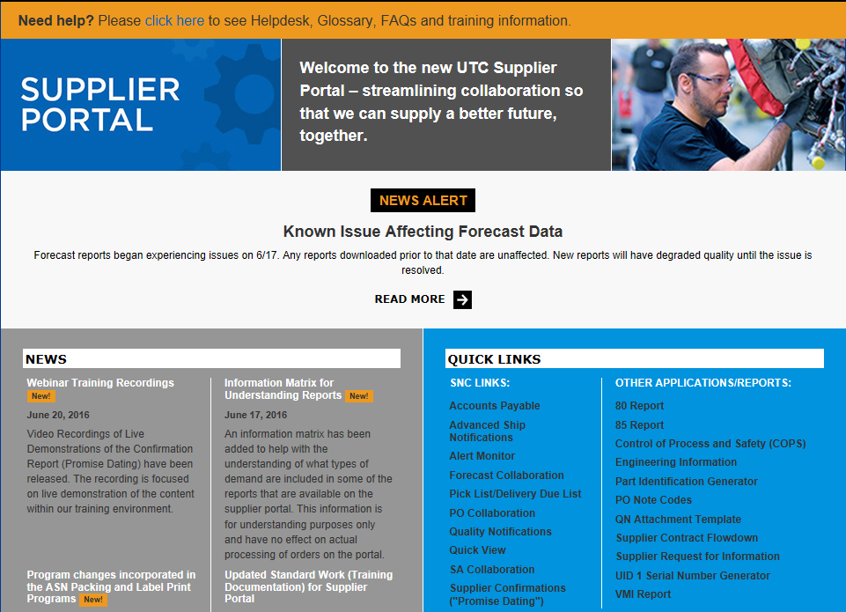
COPS Database Access
For suppliers: To access COPS, logon to the UTC Aerospace Systems Supplier Portal:
https://suppliers.utc.com/Pages/Home
Click on the “Control of Process and Safety (COPS)” link
For the link to be visible the user must first request access from their designated Supplier Portal Admin.
Once the supplier admin verifies the users citizenship they can request access for COPS under-
manage users > restricted access
The access request will go to the COPS administrator to disposition, for issues or questions contact
gputascops@hs.utc.com
** See Appendix A for Instructions on
launching COPS in Compatibility Mode

Slide 9
COPS: COMPLETING A FROZEN PROCESS
Step 1: Selecting the FSC/CTQP. From the COPS Summary Screen, select “View/Edit” to go to that FSC/CTQP’s Frozen Process Screen.
Notes:
All fake data.
9

Slide 10
COPS: COMPLETING A FROZEN PROCESS
Step 2: Selecting the Document. Once the FSC/CTQP has been opened, select “Add Document”.
Notes:
All fake data.
10

Slide 11
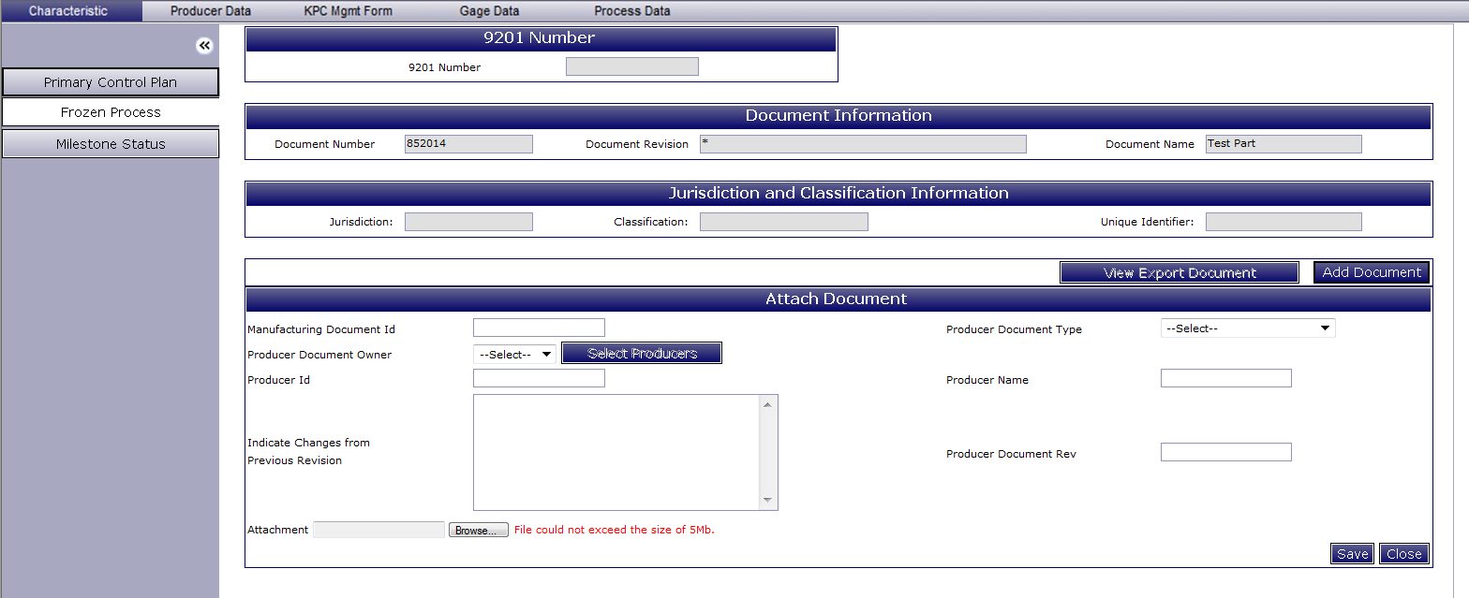
COPS: COMPLETING A FROZEN PROCESS
Step 3: Attach Document. Fill out these required fields to define the process:
Manufacturing Document ID – Producer’s OP sheet number, weld schedule ID, traveler title, etc.
Note: This field needs to be a unique identifier and cannot be used again on another characteristic even if the same documentation is used.
Producer Document Owner from the drop down list – Either Self (yours) or Subtier (your subtier).
Note: For Self, the “Select Producers” button is not needed.
Note: For Subtier, click on “Select Producers” to pick subtier producer(s) from a list. (See next slide for details)
Producer ID auto populates after selecting Producer Document Owner (read only).
Indicate Changes from Previous Revision – Enter “New” if the document is being submitted for the first time or describe the changes if it is a revision.
Attach the relevant information for the process.
Producer Document Type selected from the drop down list.
Producer Name auto populates after selecting Producer Document Owner (read only).
Producer Document Revision – The revision of the document being submitted (letter, number, date, etc).
Save when finished.
Note: Close will exit without saving.
1
6
2
3
7
4
8
5
9
Notes:
All fake data.
11

Slide 12
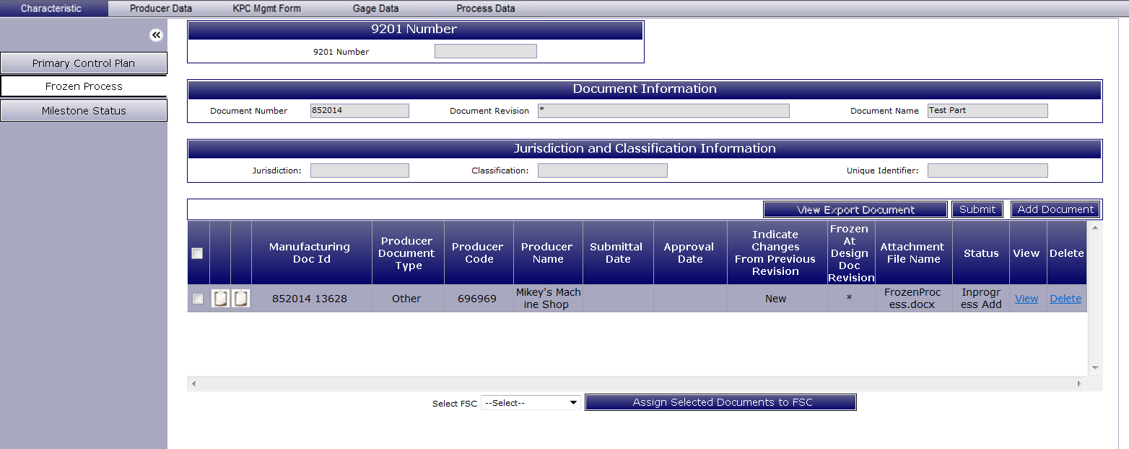
COPS: COMPLETING A FROZEN PROCESS
A document that defines part of the process has now been created in the Frozen Process tab. More documents can be created as needed to completely define the whole process to be frozen by repeating the instructions on the previous slides.
After adding all the required documentation, the definition of the frozen process is completed by associating the documents to a FSC/CTQP characteristic by following the instructions on the next slides.
Notes:
All fake data.
12

Slide 13
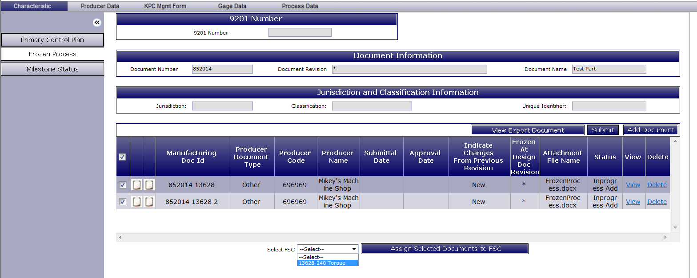
COPS: COMPLETING A FROZEN PROCESS
Step 4A: Select the documentation that is needed to define the frozen process for the FSC/CTQP characteristic. One or more may be associated to a FSC/CTQP characteristic.
Note: Check the top box to select all.
Step 4B: Select the applicable FSC/CTQP characteristic from the pull-down list.
Step 4C: Click on the “Assign Selected Documents to FSC/CTQP” button.
Notes:
All fake data.
13

Slide 14
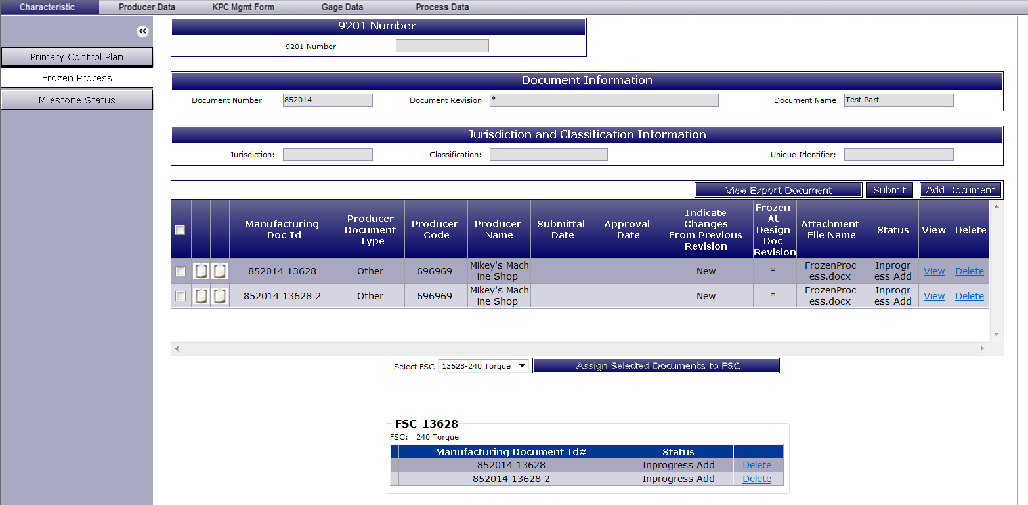
COPS: COMPLETING A FROZEN PROCESS
The FSC/CTQP is now associated with its process document(s).
Step 5: Submit. When the Frozen Process is rea554857dy for submittal, select “Submit”.
Step 4D: Select the documentation that is needed to define the frozen process for the FSC/CTQP characteristic. One or more may be associated to a FSC/CTQP characteristic. Note: Check the top box to select all.
Notes:
All fake data.
14

Slide 15
COPS: COMPLETING A FROZEN PROCESS
After being submitted, the status of the Frozen Process will change from “Draft” to “Submitted” in the COPS Summary Screen.
Review Board Response. After being reviewed, if the process is acceptable, the status will display “Approved” and the process will be considered frozen.
Notes:
All fake data.
15

Slide 16
COPS: MODIFYING AN APPROVED FROZEN PROCESS
To start updating an approved frozen process, select “View/Edit”.
Notes:
All fake data.
16

Slide 17
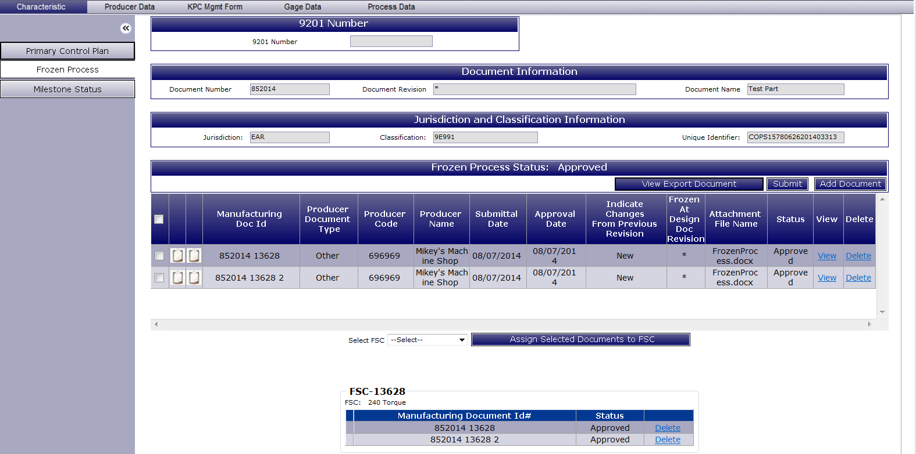
COPS: MODIFYING AN APPROVED FROZEN PROCESS
Add Document: To add a Document, select “Add Document” and follow the previous Completing a Frozen Process instructions.
Edit: In order to update an attached Document on an approved Frozen Process, select the first paper icon to “View” the attached Document. See next slides for details.
Notes:
All fake data.
17

Slide 18
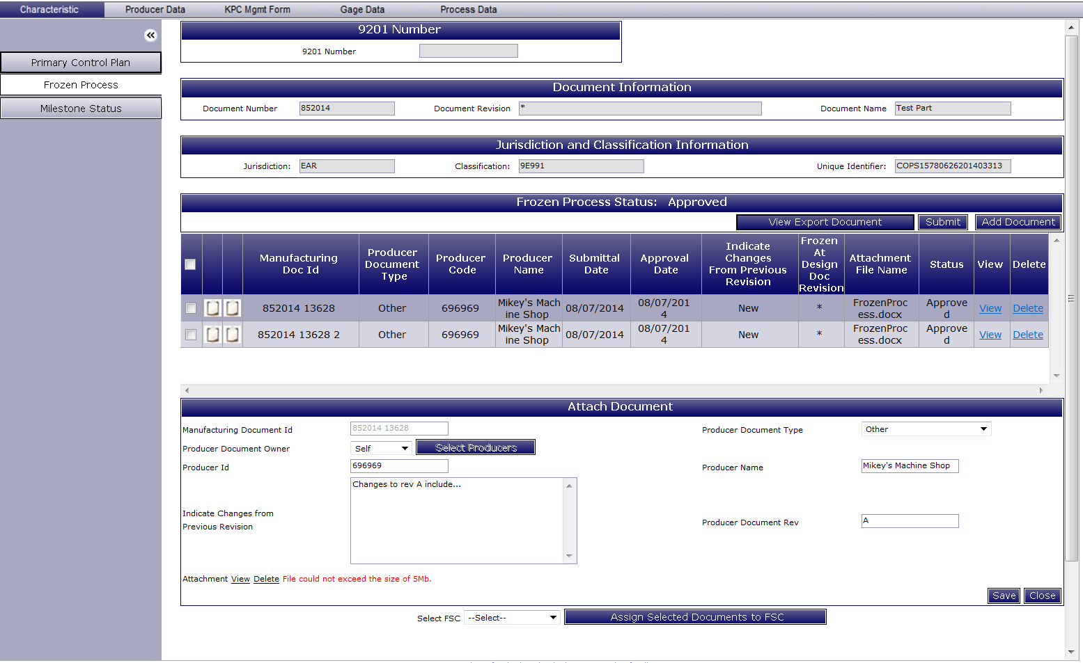
COPS: MODIFYING AN APPROVED FROZEN PROCESS
Make the appropriate changes in the Attach Document display and then select “Save”.
Notes:
All fake data.
18

Slide 19
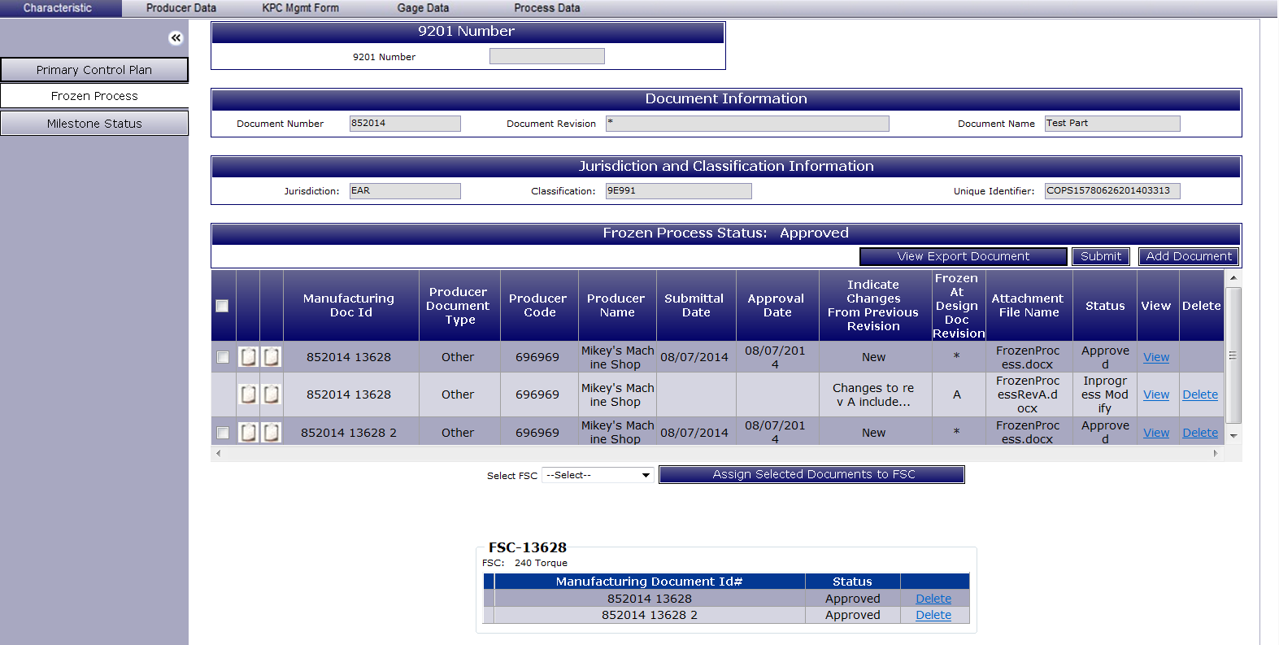
COPS: MODIFYING AN APPROVED FROZEN PROCESS
The changes will be saved as a duplicate document with the status “In Process Modify” underneath the original document pending approval.
When the process is ready for re-submittal, select “Submit”. Once approved, the original will be modified.
Notes:
All fake data.
19

Slide 20
COPS: DELETING PART OF AN APPROVED FROZEN PROCESS
To start deleting part of an approved frozen process, select “View/Edit”.
Notes:
All fake data.
20

Slide 21
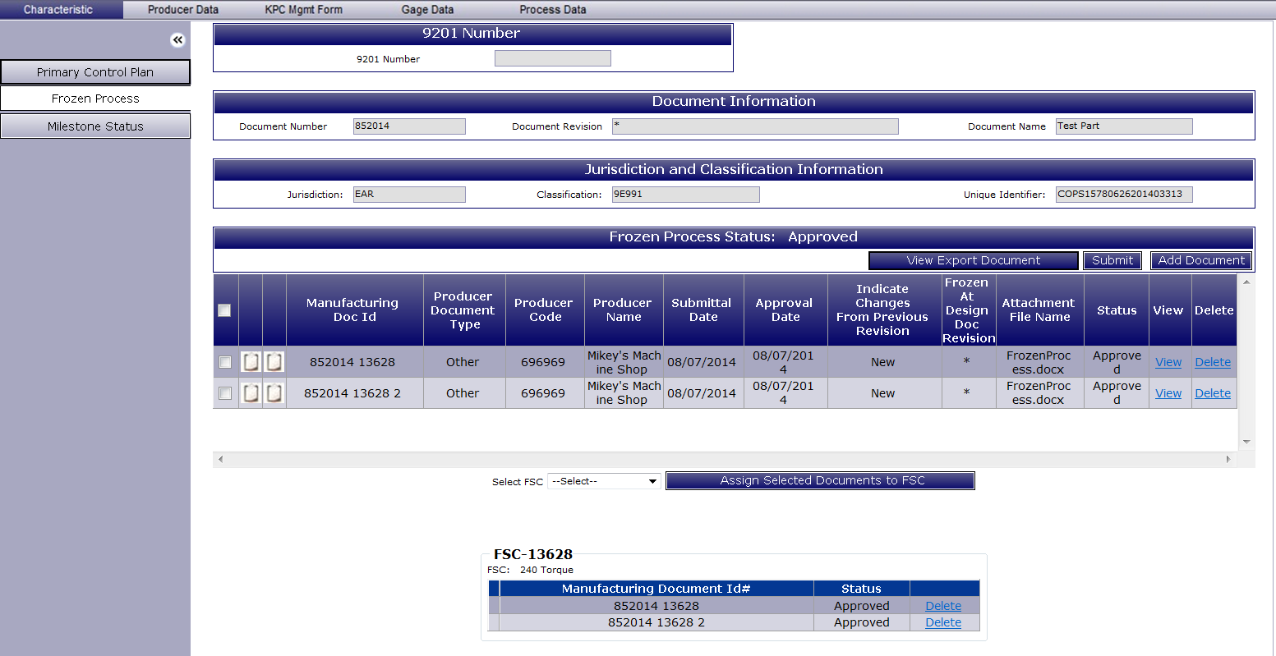
COPS: DELETING PART OF AN APPROVED FROZEN PROCESS
In an approved Frozen Process, to delete an attached Document, select “Delete” next to the Document. This will also delete any relation between a Document assigned to a FSC/CTQP.
To delete the relation between a Document assigned to a FSC/CTQP without deleting the attached Document, select “Delete” next to the Document under the FSC/CTQP.
Notes:
All fake data.
21

Slide 22
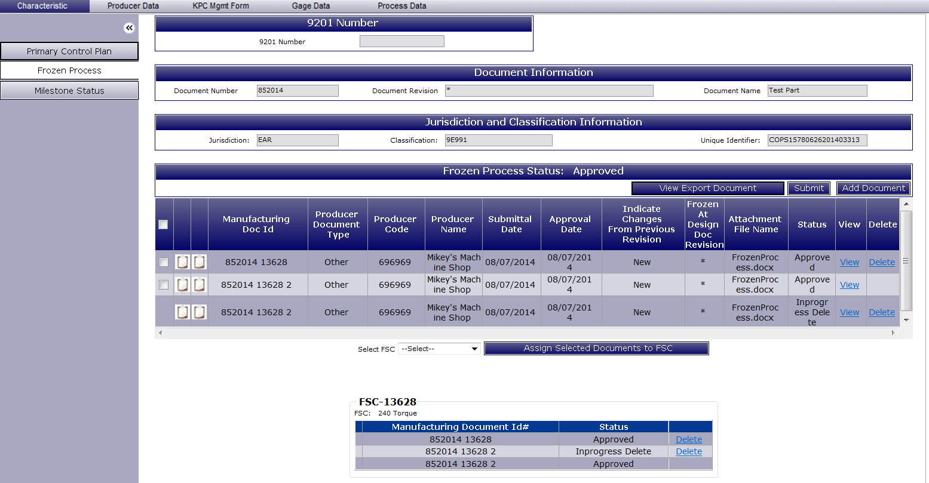
COPS: DELETING PART OF AN APPROVED FROZEN PROCESS
The delete request will appear as a duplicate document/association with the status “In Process Delete” next to the original document/association.
Once all required delete requests have been created and are ready for re-submittal, select “Submit”. Once approved, the original document will be deleted.
Note: The delete requests can be cancelled by selecting “Delete”.
Notes:
All fake data.
22

Slide 23
COPS: REWORKING A FROZEN PROCESS
If the process needs improvement or changes, the status will display “Rework”.
To start reworking, select “View/Edit”.
Notes:
All fake data.
23

Slide 24
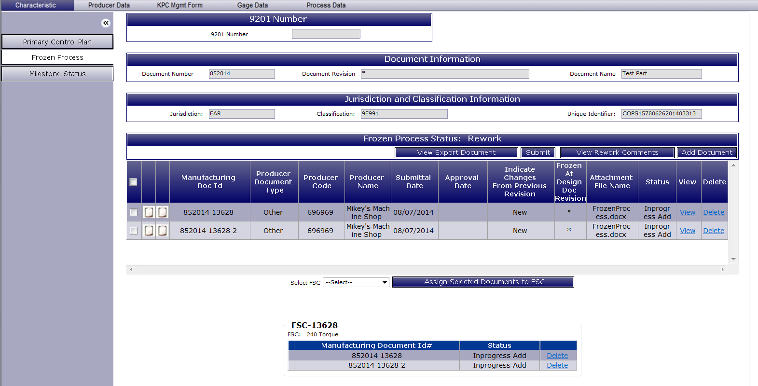
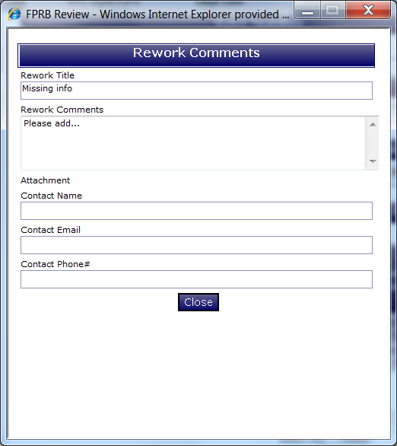
COPS: REWORKING A FROZEN PROCESS
In order to view rework comments, select “View Rework Comments”.
This Rework Comments window will display all relevant information as to why the submittal needs to be reworked.
Close the window to start applying changes.
Notes:
All fake data.
24

Slide 25
COPS: REWORKING A FROZEN PROCESS
Add Document: To add a Document, select “Add Document” and follow the previous Completing a Frozen Process instructions.
Delete Document: To delete an attached Document, select “Delete” next to the Document. This will also delete any relation between a Document assigned to a FSC/CTQP.
Note: Attached documents and document relations cannot be deleted from Frozen Processes with a status of “Submitted”.
Delete Association: To delete the relation between a Document assigned to a FSC/CTQP without deleting the attached Document, select “Delete” next to the Document under the FSC/CTQP.
Edit Document: In order to rework an attached Document, select the first paper icon to “View” the attached Document. See next slides for details.
Notes:
All fake data.
25

Slide 26
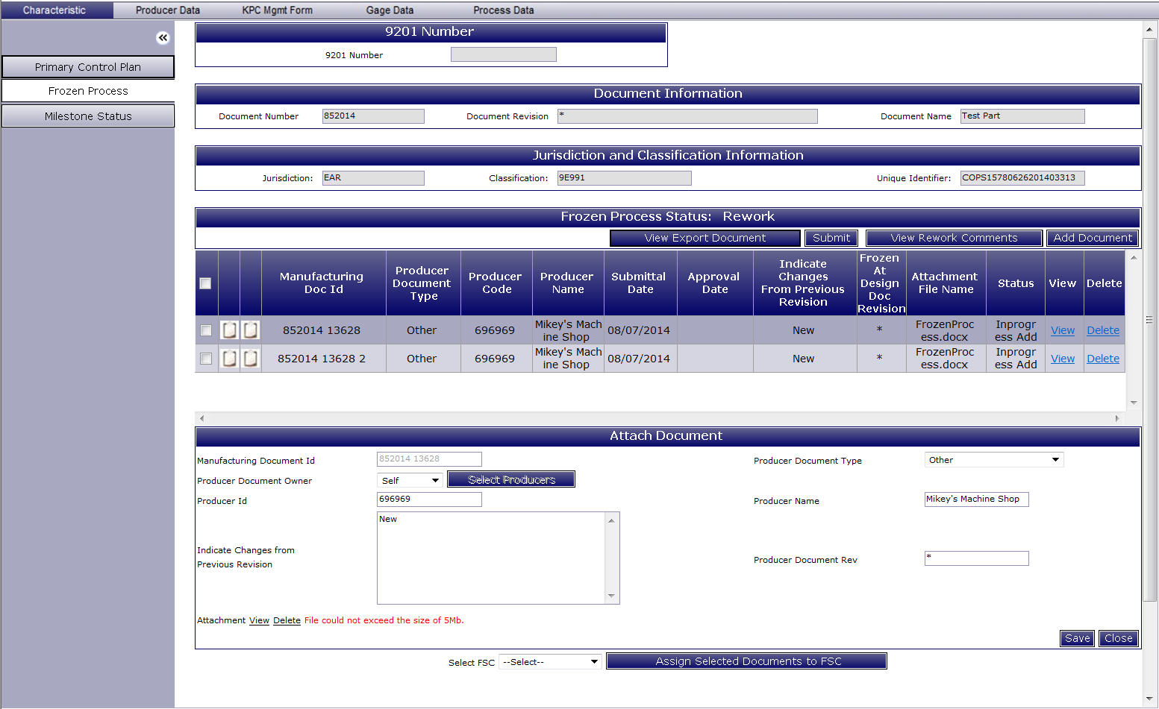
COPS: REWORKING A FROZEN PROCESS
Edit Document: Make the appropriate changes in the Attach Document window and then select “Save”.
Notes:
All fake data.
26

Slide 27
COPS: REWORKING A FROZEN PROCESS
The changes from editing will be saved into the attached Document.
When the process is ready for re-submittal, select “Submit”.
Notes:
All fake data.
27

Slide 28
MILESTONE STATUS SCREEN
Frozen Process Characteristics
Select the “Milestone Status” tab.
Indicates date of highest milestone achievement. In this case Milestone 2 was achieved on 07/24/2014.
Indicates if Milestone 1 has been achieved (KCR has been performed).
Indicates if Milestone 2 has been achieved (Frozen process documents submitted).
Indicates if Milestone 3 has been achieved (Compliance audit has been conducted and all items closed).
Indicates if Milestone 4 has been achieved (Frozen process documents have been approved).
Notes:
Fake data

