Slide 1
Cops
CtSC CTQC
Instructions

Slide 2
Control Of Process & Safety (COPS)
Table of contents
COPS overview
Matrix of Critical to Quality Features
Process Overview
Supplier Responsibilities
COPS Database Access
Submission of Producer Defined Characteristics
Milestone Status Screen
For issues or questions contact:
gputascops@hs.utc.com

Slide 3
Control Of Process & Safety (COPS)
The Control Of Process & Safety (COPS) database is the result of merging the Process Certification and Flight Safety databases.
COPS is one of the many tools that Collins Aerospace employs to assure that our products meet or exceed our customer's expectations.
COPS involves the selection of critical to quality features on the Engineering drawing. There are three types of critical to quality features; those controlled by variation management techniques, those managed by frozen process techniques and those that require the producer to define their own sub-level features. These techniques have been proven to have a positive effect on form, fit, function, performance and service life.

Slide 4
WHAT ARE THE SUPPLIER DEFINED CHARACTERISTICS?
Critical To Safety Characteristics and Critical to Quality Characteristics are upper level elements or functions of a part or assembly that have the greatest impact to the safety or quality of the product.
Critical to Safety Characteristics (identified by the symbol ) and Critical to Quality characteristics (identified by the symbol ) are only applied to supplier designed items procured via Source Control or Vendor Item (Spec Control) drawings.
CTSC/CTQC’s drive the selection of lower-level processes and characteristics for variation management by the producer, that will have the most influence on the CTSC/CTQC. The supplier defined features must be approved by Collins Engineering and then be included on the supplier’s engineering documents.
CTQC

Slide 5
Matrix of Critical to Quality Features
Method of Control | Safety (CTS) | Non safety (CTQ)
Variation Management | KPC1 | KPC2
Frozen Process | FSC ( ) | CTQP
Supplier Defined * | CTSC | CTQC

Slide 6
Process Overview
CTSC / CTQC
Producer submits self-defined features with corresponding evidence for PSRB/Engineering approval
Producer controls self-defined characteristics / processes within their own system per HSC16199
Producer performs CTS / CTQ analysis and decomposition
PSRB / Engineering approves producer-selected characteristics / processes
KPC1 / KPC2
Engineering proposes key characteristics on engineering definition form to PSRB/PCRB
PSRB / PCRB approves request
Drawing released with approved key characteristics
System admin uploads key characteristics into COPS
Producer analyzes processes to identify KPIs
Producer inputs Control plan and SPC data into COPS
Producer reduces process variation until process capability requirements met
DQR validates ProCert adherence in eSILK
FSC / CTQP
Producer analyzes processes to identify KPIs and KPOs and validates using PFMEA / Control build
Producer submits frozen process documentation for FPRB / PCRB approval
FPRB / PCRB approves producer frozen process documentation
DQR validates Frozen Operation adherence in eSILK

Slide 7
Supplier Responsibilities
  Suppliers with characteristics that require supplier defined characteristics and processes (CTSCs & CTQCs) need to do the following:
  Self-select lower level process characteristics and variation management characteristics that impact the Collins defined CTSC/CTQC per Appendix B3.0 of HSC16199. A (FMEA) may be conducted on CTQ parts to determine critical process risks and methods to control them, identifying lower level keys.
  The supplier’s defined characteristics must be documented and submitted to Collins for approval in the COPS database using the HSF5138 form, available on the supplier portal.
  Once approved, the supplier shall document the self-selected characteristics on supplier’s product definition documents (drawings and specifications) in accordance with supplier’s internal systems and procedures. Suppliers are not required to populate the COPS data base with their Control Plans, Gage Studies and SPC Control Charts for their self-selected key but must maintain these records and are subject to audit and review by Collins Per HSC16199.

Slide 8
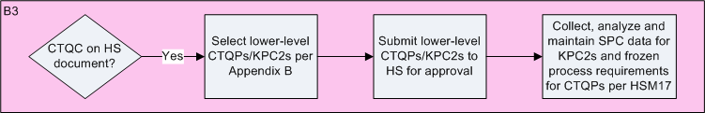
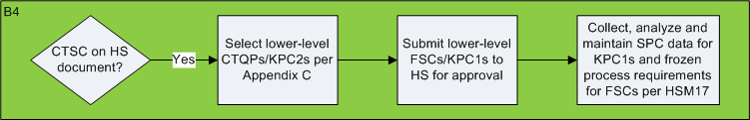
Supplier Responsibilities
  The supplier shall manufacture parts in accordance with the supplier’s internal systems and procedures using processes and variation management techniques (HSC16199 and HSM17) as applicable on the self-selected features.
Flow chart from HSC16199 sec B1.2

Slide 9
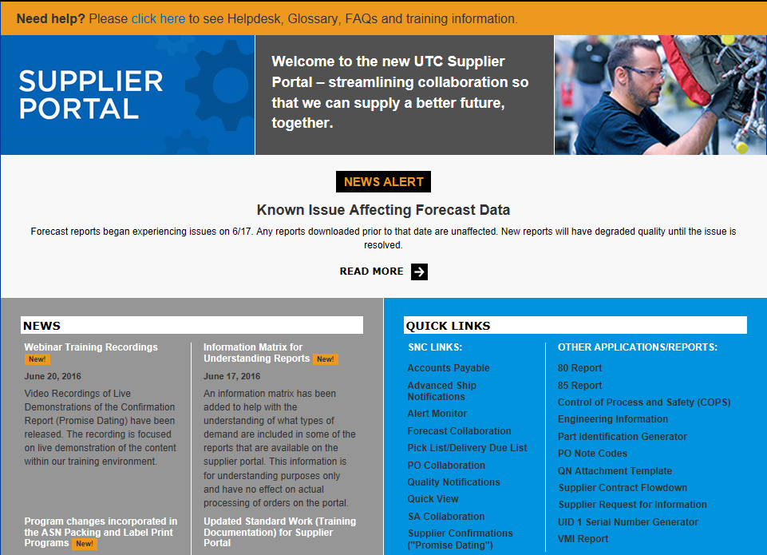
COPS Database Access
For suppliers: To access COPS, logon to the UTC Aerospace Systems Supplier Portal:
https://suppliers.utc.com/Pages/Home
Click on the “Control of Process and Safety (COPS)” link
For the link to be visible the user must first request access from their designated Supplier Portal Admin.
Once the supplier admin verifies the users citizenship they can request access for COPS under-
manage users > restricted access
The access request will go to the COPS administrator to disposition, for issues or questions contact
gpCollinscops@hs.utc.com
** See Appendix A for Instructions on
launching COPS in Compatibility Mode

Slide 10
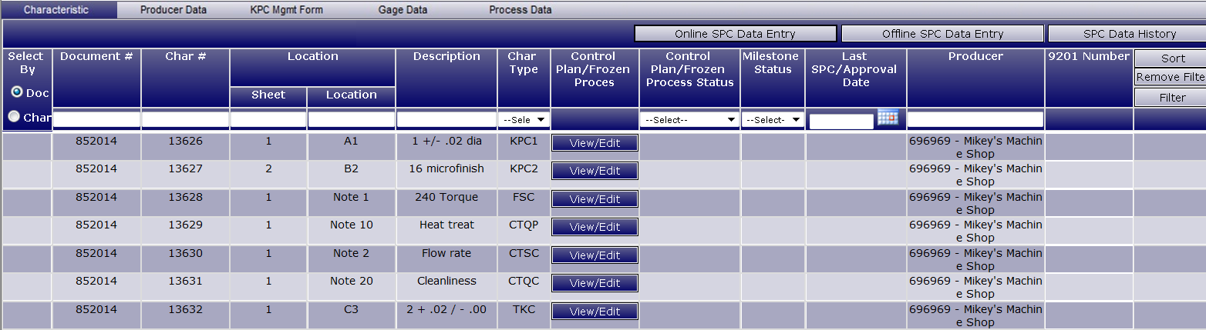
SUBMISSION OF PRODUCER DEFINED CHARACTERISTICS
Step 1: Selecting the CTQC/CTSC. From the COPS Summary Screen, select “View/Edit” to go to that CTQC/CTSC’s Supplier Defined Characteristics screen.
Notes:
Fake data

Slide 11
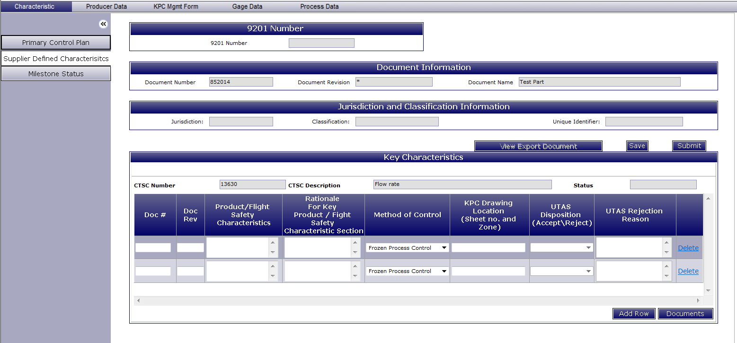
SUBMISSION OF PRODUCER DEFINED CHARACTERISTICS
Step 2: Define Key Characteristics - Fill out these required fields for the Supplier Defined Characteristics:
Doc # – Producer’s document where characteristic will be defined.
Doc Rev – Producer’s document revision (letter, number, date, etc).
Product/Flight Safety Characteristics – Description of characteristic.
Rationale for Key Product/Flight Safety Characteristic Section – Reasoning behind selection of characteristic.
Method of Control from the drop down list choose (either frozen process or variation management)
KPC Drawing Location – Sheet and zone locations on supplier document where characteristic can be found.
Add Row – Add another row to define another characteristic.
Documents – Attach any relevant documentation that supports the selection of supplier defined characteristics (HSF-5138, FMEA, risk analysis tool etc.) Note: Processes that need to be submitted for frozen approval must be attached here for any frozen process control characteristic selected for a CTSC.
Save when finished.
Submit when ready to send to Collins for review.
9
10
1
2
3
5
6
4
7
8
Notes:
Fake data

Slide 12
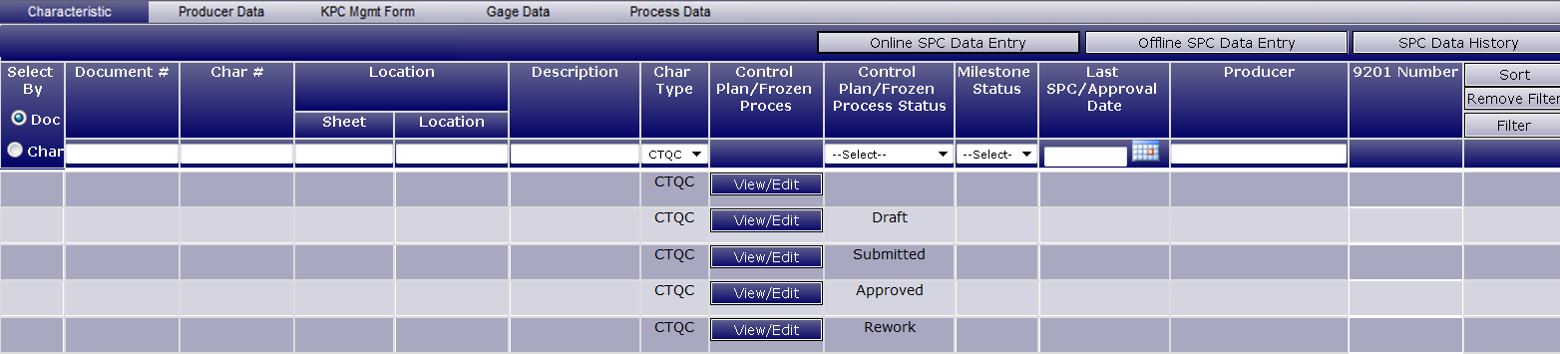
SUBMISSION OF PRODUCER DEFINED CHARACTERISTICS
If the CTQ is saved without being submitted, the status will display “Draft”. This can be completed and submitted at a later date by clicking on “View/Edit”.
When the CTQ is submitted, the status will change to “Submitted” pending Collins review.
After the Collins has performed the review, the CTQ status will change to either “Rework” or “Approved”. If the CTQ needs to be reworked, click “View/Edit”, make the appropriate changes and resubmit.
Notes:
Fake data

Slide 13
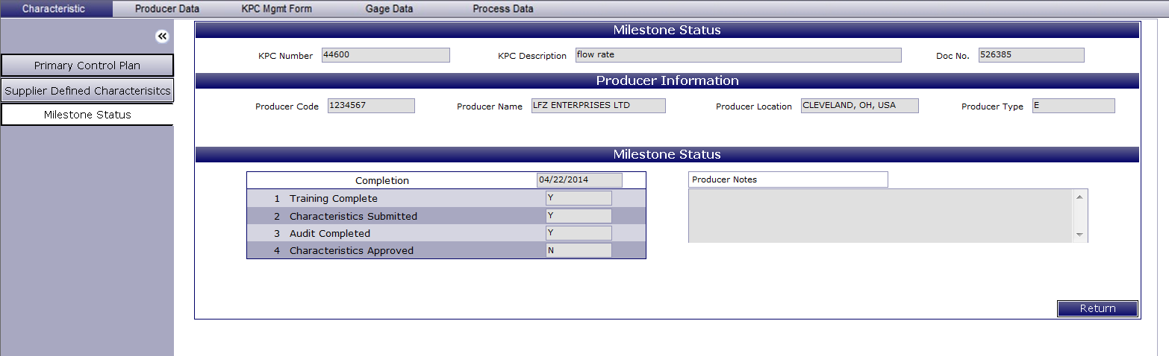
MILESTONE STATUS SCREEN
Supplier Defined Characteristics
Select the “Milestone Status” tab.
Indicates date of highest milestone achievement. In this case Milestone 3 was achieved on 04/22/2014.
Indicates if Milestone 1 has been achieved (KCR has been performed).
Indicates if Milestone 2 has been achieved (Supplier defined characteristics submitted).
Indicates if Milestone 3 has been achieved (Compliance audit has been conducted and all items closed).
Indicates if Milestone 4 has been achieved (Supplier defined characteristics approved).
Notes:
Fake data

